Slide 1
MANAGEMENT OF SERVICES ACROSS MULTIPLE CLOUDS
UPB – Computer Networks Group
Team PG-SCrAMbLE

Slide 2


SCrAMbLE - Introduction
“A software package that bridges different MANO frameworks”
Components:
Translator
Splitter
Adaptor

Slide 3
Translator

Slide 4
SCrAMbLE - Translator
Why?
To overcome schematic differences between service descriptors
How?
Create key mapping
Create a dataset with source descriptor and key map
Extract the keys and values corresponding to destination schema

Slide 5

SCrAMbLE - Translator
vnfd-catalog:
schema-version: v1
vnfd:
id: loadbalancer-vnf
mgmt-interface:
cp: mgmt
name: loadbalancer-vnf
vdu:
- id: vdu01
image: loadbalancer-image
vm-flavor:
memory-mb: 1024
storage-gb: 5
vcpu-count: 1
interface:
- external-connection-point-ref: input
name: eth1
position: 2
:
:
descriptor_version: v1
vendor: pg-scramble
name: loadbalancer-vnf
version: '0.1'
author: pg-scramble
virtual_deployment_units:
- id: vdu01
vm_image: loadbalancer-image
vm_image_format: qcow2
resource_requirements:
cpu:
vcpus: 1
memory:
size: 1024
size_unit: MB
storage:
size: 5
size_unit: GB
:
:
TRANSLATOR
NSD/VNFD
NSD/VNFD

Slide 6
SCrAMbLE - Translator
vnfd-catalog:
schema-version: v1
vnfd:
id: loadbalancer-vnf
mgmt-interface:
cp: mgmt
name: loadbalancer-vnf
vdu:
- id: vdu01
image: loadbalancer-image
vm-flavor:
memory-mb: 1024
storage-gb: 5
vcpu-count: 1
interface:
- external-connection-point-ref: input
name: eth1
position: 2
:
:
descriptor_version: v1
vendor: pg-scramble
name: loadbalancer-vnf
version: '0.1'
author: pg-scramble
virtual_deployment_units:
- id: vdu01
vm_image: loadbalancer-image
vm_image_format: qcow2
resource_requirements:
cpu:
vcpus: 1
memory:
size: 1024
size_unit: MB
storage:
size: 5
size_unit: GB
:
:
TRANSLATOR
NSD/VNFD
NSD/VNFD

Slide 7
Splitter

Slide 8
SCrAMbLE - Splitter
Why?
To deploy network services over different MANO frameworks
How?
Validation of the request
Components are stored in python classes objects
Creates separate sub NSDs
Creates external points for sub NSDs
Splits the virtual links
Splits the forwarding graph (POC)

Slide 9
SCrAMbLE - Splitter
descriptor_version: "1.0"
vendor: "eu.sonata-nfv.service-descriptor"
name: "sonata-demo-vtc"
version: "0.1"
​
network_functions:
- vnf_id: "vnf_vtc"
vnf_vendor: "eu.sonata-nfv"
vnf_name: "vtc-vnf"
vnf_version: "0.1”
:
:
Pishahang / OSM
descriptor_version: "1.0"
vendor: "eu.sonata-nfv.service-descriptor"
name: "sonata-demo-vtc"
version: "0.1"
​
network_functions:
- vnf_id: "vnf_vtc"
vnf_vendor: "eu.sonata-nfv"
vnf_name: "vtc-vnf"
vnf_version: "0.1"
- vnf_id: "vnf_firewall"
vnf_vendor: "eu.sonata-nfv"
vnf_name: "firewall-vnf"
vnf_version: "0.1”
:
:
:
SPLITTER
NSDs
descriptor_version: "1.0"
vendor: "eu.sonata-nfv.service-descriptor"
name: "sonata-demo-vtc"
version: "0.1"
​
network_functions:
- vnf_id: "vnf_firewall"
vnf_vendor: "eu.sonata-nfv"
vnf_name: "firewall-vnf"
vnf_version: "0.1”
:
:
NSD

Slide 10
SCrAMbLE - Splitter
descriptor_version: "1.0"
vendor: "eu.sonata-nfv.service-descriptor"
name: "sonata-demo-vtc"
version: "0.1"
​
network_functions:
- vnf_id: "vnf_vtc"
vnf_vendor: "eu.sonata-nfv"
vnf_name: "vtc-vnf"
vnf_version: "0.1”
:
:
Pishahang / OSM
descriptor_version: "1.0"
vendor: "eu.sonata-nfv.service-descriptor"
name: "sonata-demo-vtc"
version: "0.1"
​
network_functions:
- vnf_id: "vnf_vtc"
vnf_vendor: "eu.sonata-nfv"
vnf_name: "vtc-vnf"
vnf_version: "0.1"
- vnf_id: "vnf_firewall"
vnf_vendor: "eu.sonata-nfv"
vnf_name: "firewall-vnf"
vnf_version: "0.1”
:
:
:
SPLITTER
NSDs
descriptor_version: "1.0"
vendor: "eu.sonata-nfv.service-descriptor"
name: "sonata-demo-vtc"
version: "0.1"
​
network_functions:
- vnf_id: "vnf_firewall"
vnf_vendor: "eu.sonata-nfv"
vnf_name: "firewall-vnf"
vnf_version: "0.1”
:
:
NSD

Slide 11
Adaptor

Slide 12
SCrAMbLE - Adaptor
Why?
Provide interaction between MANO instances
How?
Wrapping REST APIs of OSM and Pishahang
Semi-automated python base class generation from ETSI document
Enforce ETSI endpoints for all MANOs

Slide 13
SCrAMbLE - Adaptor
OSM Request
Onboard NS
Deploy NS
:
:
ADAPTOR

Slide 14
SCrAMbLE - Adaptor
ADAPTOR
OSM Request
Onboard NS
Deploy NS
:
:

Slide 15
SCrAMbLE - Adaptor
Pishahang Request
Onboard NS
Deploy NS
:
:
ADAPTOR

Slide 16
SCrAMbLE - Adaptor
ADAPTOR
Pishahang Request
Onboard NS
Deploy NS
:
:

Slide 17
SCrAMbLE - Adaptor
Adaptor Design
Automated testing
Well documented
https://python-mano-wrappers.readthedocs.io/en/adaptor/
Easy to install and use
pip install python-mano-wrappers

Slide 18
Overview

Slide 19
SCrAMbLE - Overview
Request
Request
SCrAMbLE Plugin
TRANSLATOR
SPLITTER
ADAPTOR
SCrAMbLE Plugin

Slide 20
SCrAMbLE - Overview
SCrAMbLE Plugin
TRANSLATOR
SPLITTER
ADAPTOR
Request
Request
SCrAMbLE Plugin

Slide 21
Demo Scenario
Network Service
NGINX Server1
Client
VNF1
(Sniffer +
Classifier)
VNF2
(Firewall)
VNF3
(Load Balancer)
NGINX Server2

Slide 22


Demo Scenario
MANO 1
VIM(Openstack)
NGINX 1
Client
MANO 2
VIM(Openstack)
NGINX 2
MANO 3
VIM(Openstack)

Slide 23
Demo Scenario
Network Service
Classifier
Firewall
LB
MANO 1
VIM(Openstack)
NGINX 1
Client
MANO 2
MANO 3
NGINX 2
VIM(Openstack)
VIM(Openstack)

Slide 24
Demo Scenario
Network Service
MANO 1
VIM(Openstack)
Classifier
NGINX 1
Client
MANO 2
MANO 3
Firewall
LB
NGINX 2
VIM(Openstack)
VIM(Openstack)

Slide 25
Demo Scenario
Network Service
MANO 1
VIM(Openstack)
Classifier
NGINX 1
Client
MANO 2
MANO 3
NGINX 2
VIM(Openstack)
VIM(Openstack)
Firewall
LB

Slide 26
Demo Scenario
Network Service
MANO 1
VIM(Openstack)
Classifier
NGINX 1
Client
MANO 2
MANO 3
NGINX 2
VIM(Openstack)
VIM(Openstack)
Firewall
LB

Slide 27


SCrAMbLE
DEMO —>
Parent MANO
Child MANO1
Child MANO2

Slide 28
Demo Scenario
Network Service
MANO 1
VIM(Openstack)
Classifier
NGINX 1
Client
MANO 2
MANO 3
NGINX 2
VIM(Openstack)
VIM(Openstack)
Firewall
LB

Slide 29
Demo Scenario
Network Service
MANO 1
VIM(Openstack)
Classifier
NGINX 1
Client
MANO 2
MANO 3
NGINX 2
VIM(Openstack)
VIM(Openstack)
Firewall
LB

Slide 30
MANO Scalability

Slide 31
SCrAMbLE – MANO Scalability
Two Directions
Hierarchical scaling plugin in Pishahang
Experiment on OSM and Pishahang to characterize resource utilization

Slide 32
1. Scalability Plugin

Slide 33
SCrAMbLE - MANO Scalability
Pishahang Scaling Plugin
Use existing infrastructure to scale-out MANO
Add ability to Pishahang to scale itself
Create and manage child instances
Act based on linux system load average values
1m, 5m, 15m moving averages

Slide 34
SCrAMbLE - MANO Scalability
On warning threshold reached (5m > 0.7)
Instantiate a child MANO instance
Add metadata (user, pass, IP) to a list of active child instances
Monitor load on child instances
On critical threshold reached (15m > 0.7)
Forward incoming requests to child instances
Load subsides on both MANOs
Terminate child instance
Store metadata (NSR, VNFR) from child MANO

Slide 35
SCrAMbLE - MANO Scalability
DEMO —>

Slide 36
2. Experiments

Slide 37
SCrAMbLE - MANO Scalability
Experiments on OSM and Pishahang
Record how various microservices behave
CPU utilization
Linux load averages (1m, 5m, 15m)
Memory utilization
Use python-mano-wrappers to continuously send requests to MANOs
Visualize with graphs

Slide 38
2.1 OSM

Slide 39
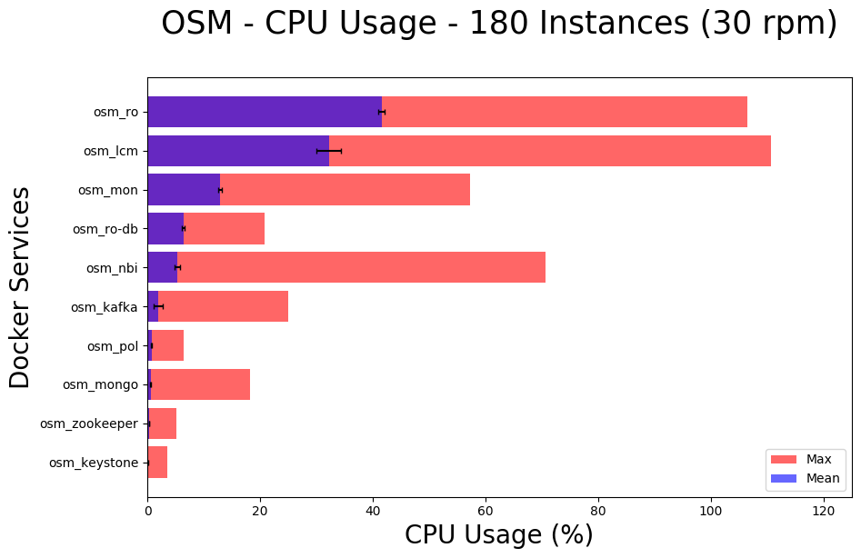
SCrAMbLE - MANO Scalability

Slide 40
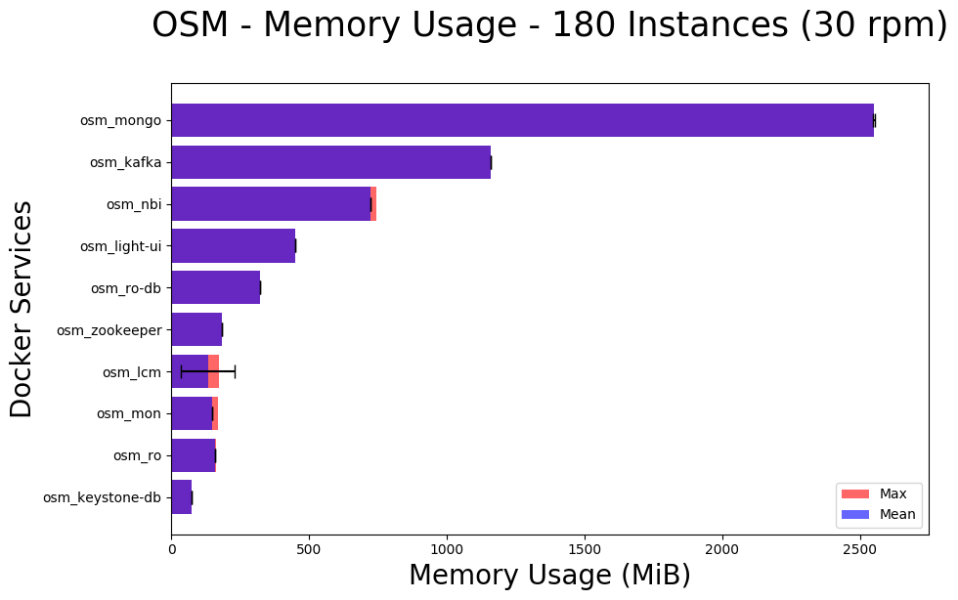
SCrAMbLE - MANO Scalability

Slide 41
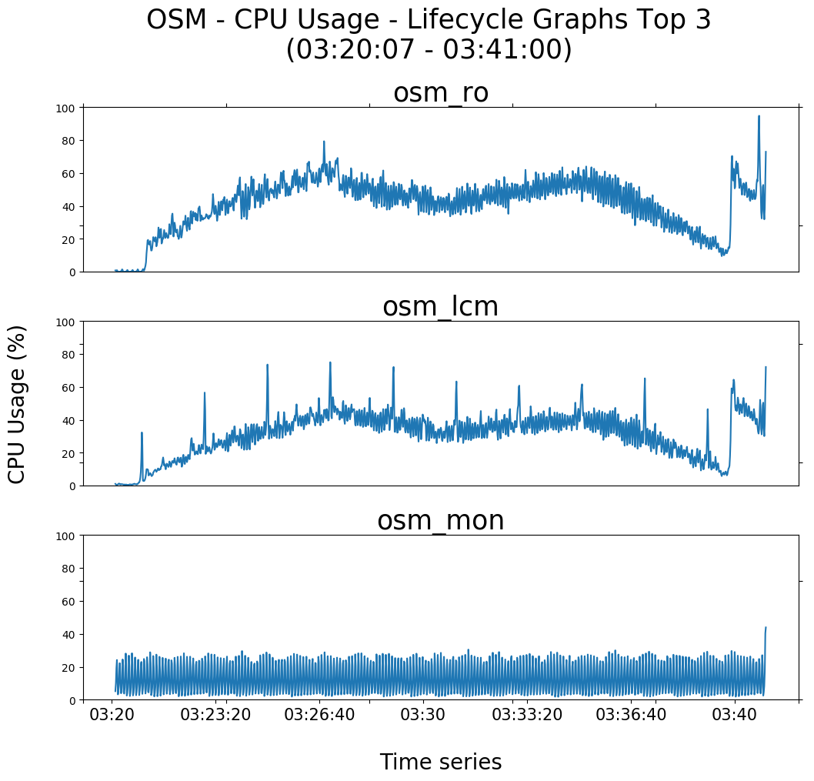
SCrAMbLE - MANO Scalability

Slide 42
2.2 Pishahang

Slide 43
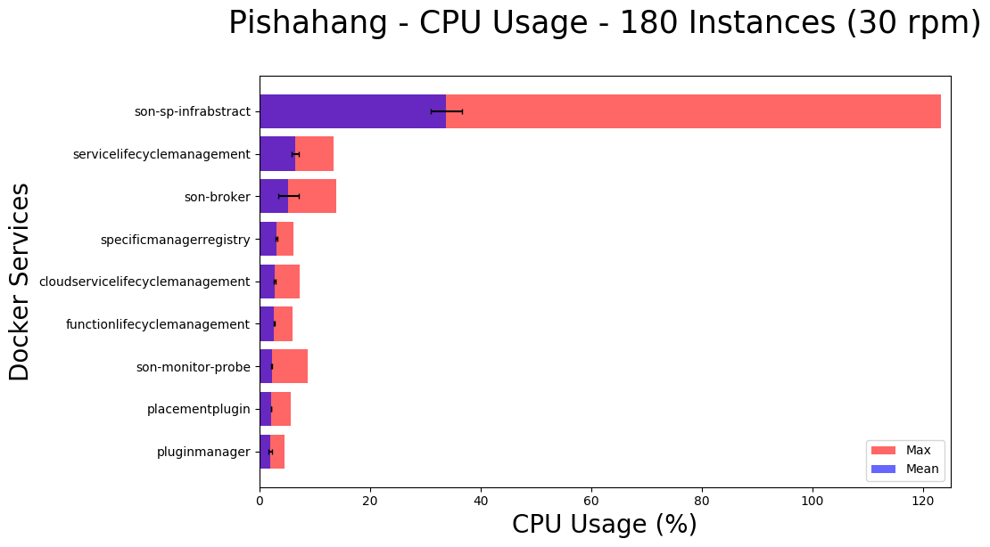
SCrAMbLE - MANO Scalability

Slide 44
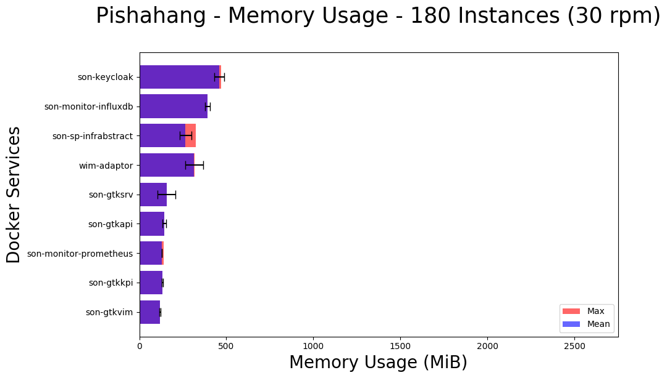
SCrAMbLE - MANO Scalability

Slide 45
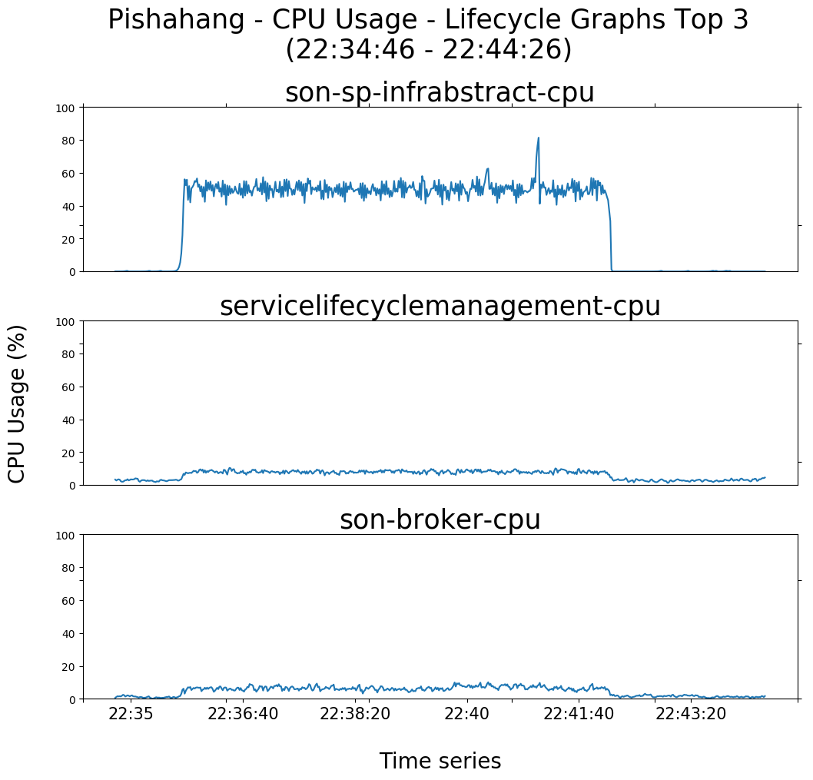
SCrAMbLE - MANO Scalability

Slide 46
SCrAMbLE - MANO Scalability
What else can we do with this?
Turn this script into a MANO Benchmarking Tool?
Resource characterization and analytics for MANO developers
Should be easy to use and test MANOs under different conditions

Slide 47
MANO Benchmarking Framework

Slide 48
SCrAMbLE – MANO Benchmarking
MANO Benchmarking Framework
Netdata: Monitoring system, REST API
Docker Environment: Portable, Reproducible
Python: Scripting, Parameters
python-mano-wrappers: Automate the MANO workflow
Google Charts: Easy graphs
Matplotlib: Flexible graph generation
Flask + JS: UI for graphs, Sorted tables

Slide 49
SCrAMbLE – MANO Benchmarking
NSDs and VNFDs
Images: Cirros, Ubuntu
Requests per minute
Observation time
KPI
Parameters
CPU
System Load
Memory
Success ratio
End-to-end deployment time
Individual deployment time
NFVO vs VIM

Slide 50
SCrAMbLE – MANO Benchmarking
Examples of results
Scalability plugin comparison
Multiple NS comparison

Slide 51
Evaluation of scaling plugin

Slide 52
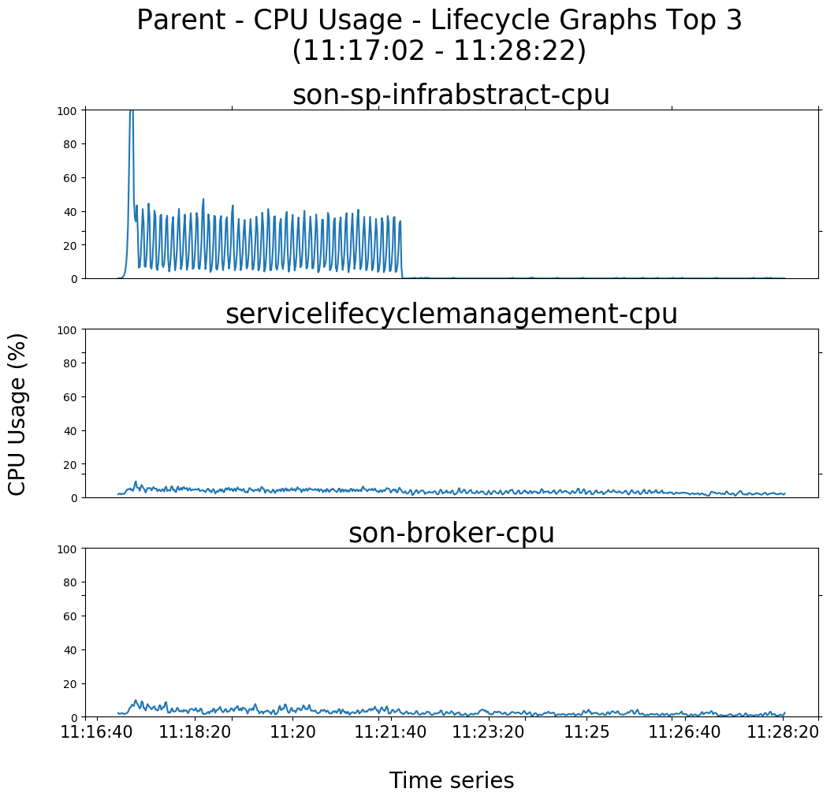
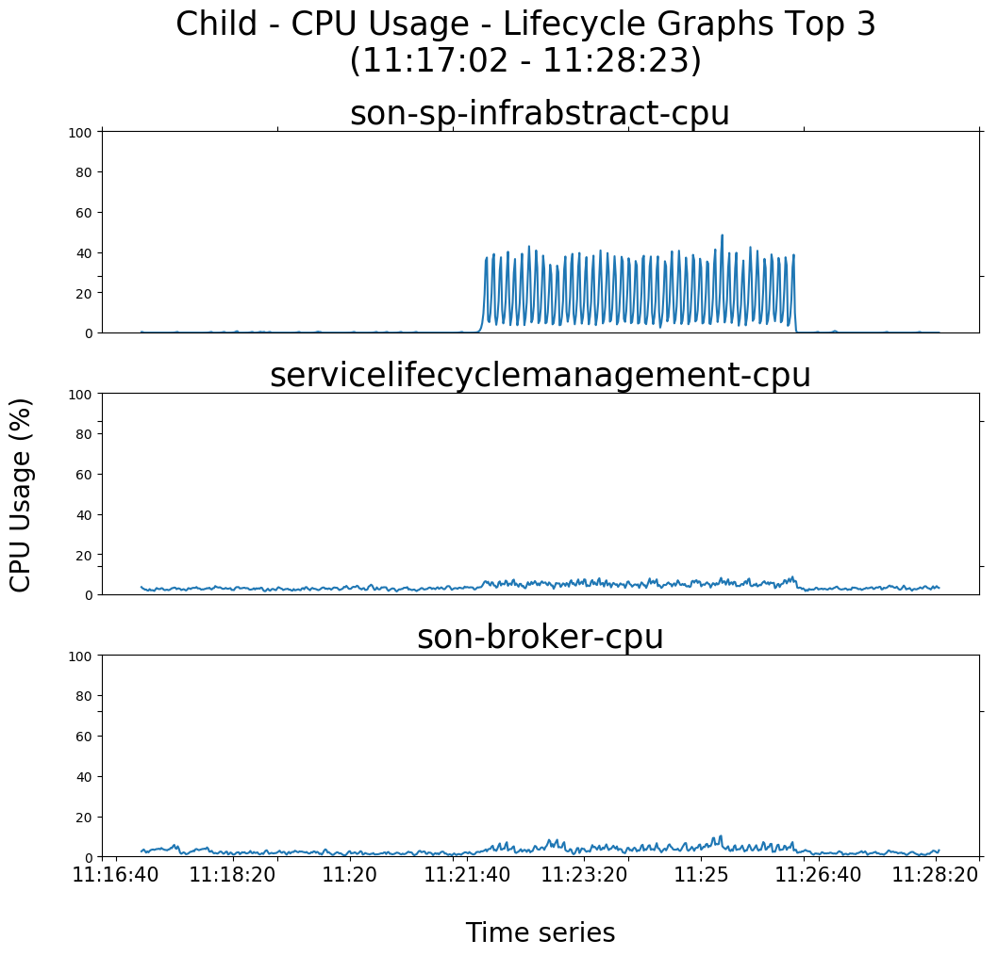
SCrAMbLE – MANO Benchmarking

Slide 53
Multiple NS Comparison

Slide 54
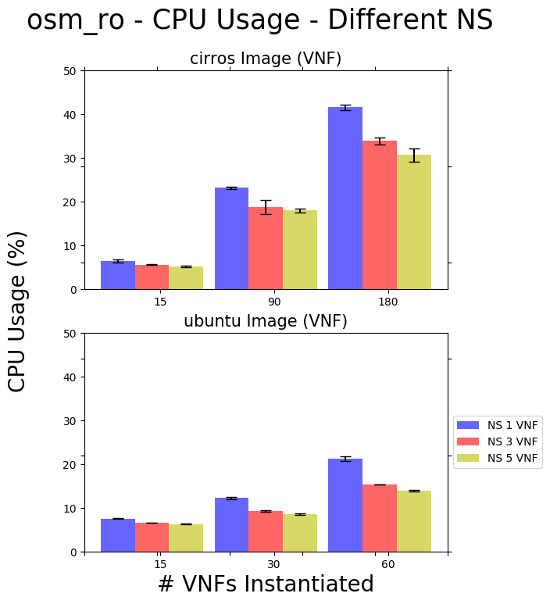
SCrAMbLE – MANO Benchmarking

Slide 55
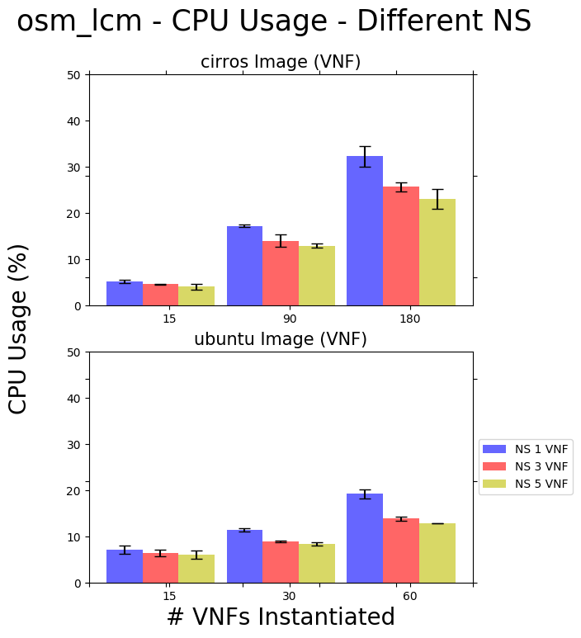
SCrAMbLE – MANO Benchmarking

Slide 56
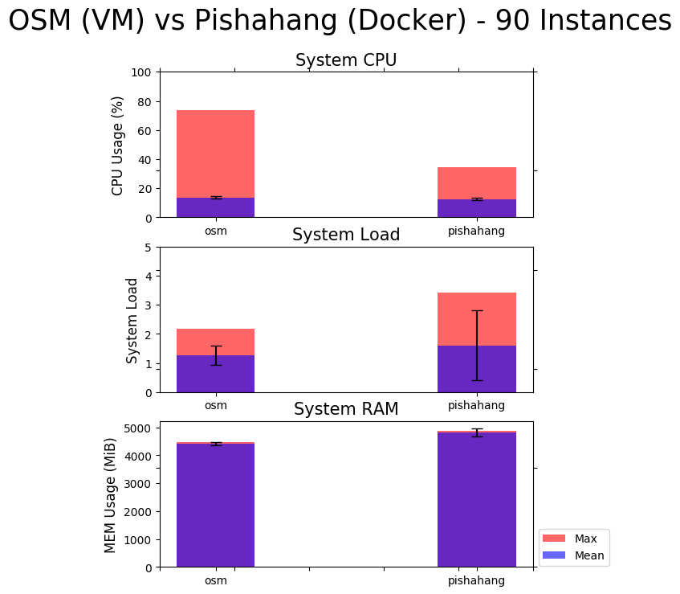
SCrAMbLE – MANO Benchmarking

Slide 57
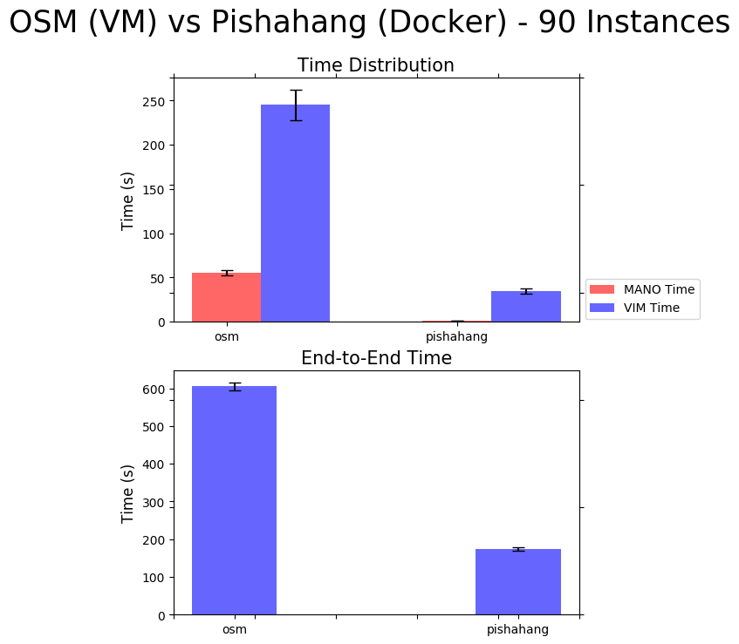
SCrAMbLE – MANO Benchmarking

Slide 58
SCrAMbLE – MANO Benchmarking Suite
Blockers
VIM Infrastructure
16 cores --> ~180 virtual instances
VM and Container support
Pishahang not stable for VM experiments (openstack)
OSM doesn't support containers (kubernetes)

Slide 59
Conclusion

Slide 60
SCrAMbLE – Conclusion
Management of services across multiple clouds has been achieved!
- Team PG-SCrAMbLE
Notes:
As Seen from the demo, With Scramble we have achieved interoperability between OSM and Pishahang and also realized hierarchical orchestration. With simple interface the end users can now instantiate and manage services across multiple clouds.

Slide 61
SCrAMbLE – Conclusion
There are three states of being. Not knowing, action and completion.
Notes:
I am sure that each one of the member in this team have gone through these three states. We started with not knowing and with hard work over the past one year, we have reached completion. I believe we Pg-scramble as a team have worked hard enough to meet the expectations of the "Clients".

Slide 62
SCrAMbLE – Conclusion
Thank You!
Notes:
For this I would like to thank Hadi n Sevil for guiding us throught the project and each of the team members for working as one, supporting each other, bringing forward various innovative ideas and tackling problems that seemed impossible to achieve at times.

